Slide 1
Department of Electronics and Communication Engineering
M.I.E.T. ENGINEERING COLLEGE
AIR AMBULANCE
Presented by : Karthick Pandiyan R
Ayyanar.S
Abdul Aziz M
Jegan.J
Guide : Dr. Ayshathul Fouzia Abdul Gani
27-03-2023

Slide 2
Outline of Presentation
Objective of the project
Introduction to proposed methodology
Existing methodologies in literature
Proposed methodology
Introduction to simulation tools used
Outline of the Work / Work Done
References
2/12

Slide 3
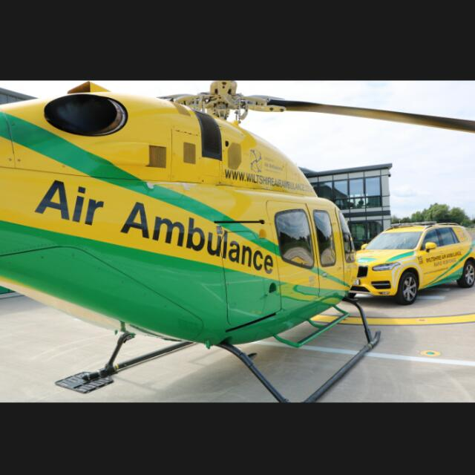
Motivation
Motivation
The ever increasing traffic congestion on roads is creating a challenge for ambulance drivers in finding way to reach hospitals to save the lives of people in casuality.
The objective of the proposed work is to circumvent the heavy traffic zones by introduced manned air-ambulance.
Fig. 1– Biomedical applications
3/12

Slide 4
Introduction to proposed methodology
Technology scaling – high levels of integration in vehicle design.
The proposed vehicle is designed using manned drones and helium gas balloons that helps them move in three different means of communication namely, water, land, and air.
The main objective of the project is to create accurate and reliable output through IOT technology and embedded system to save lives
4/12

Slide 5
Existing methodologies in literature
Flying Car Transportation System: Advances, Techniques, and Challenges has proposed a method Flying Car Design
Take-off & landing (TOL) modes, pilot modes, operation modes, and power types, which are the methods related to the adaptability, flexibility & comfort, stability & complexity, and environmental friendliness of flying cars, respectively [5].
FLYING VEHICLE:
In the existing system, the vehicle can come down with the help of a parachute to assist the drone to come out and help it fly whenever the drone is in one place.
In the proposed system, the vehicle can move on land, can fly up to a certain distance with the help of a drone when and where required, and can float on water with the help of helium gas.(airbags).
5/12

Slide 6
Existing methodologies in literature
TABLE : Performance comparison of proposed AiP
Ref | Title | Parametr1 | Parameter2
[4]Altran En-Route to Urban Air Mobility on the Fast Track to Viable and Safe on-Demand Air Services.(Mar.2020) | EN-ROUTE TO URBAN AIR MOBILITY | Roadways: 30 km/hr Airways: 225 km/hr | Budget: MarketsandMarkets: $15 billion Morgan Stanley: $322 billion
6/12

Slide 7
Proposed Methodology
As new and advanced ideas are applied in biomedical applications, this project can be well used in biomedical field.
A large population of our country are of aged people and they are prone to life-threatening diseases.
In addition, due to the increasing number of vehicles on roads and because of the poor road maintenance, timely access to hospitals is a major challenge in our country.
The proposed work aims at developing a manned ambulance vehicle that can circumvent the heavy traffic by airlifting the vehicle.
By using loT technology as a solution to such situations, we can reach the hospital quickly and help the patients
A helium gas buoyancy balloon is added to the bottom of this vehicle, so this vehicle is able to float in water and can easily go to its destination even in water.
7/12

Slide 8
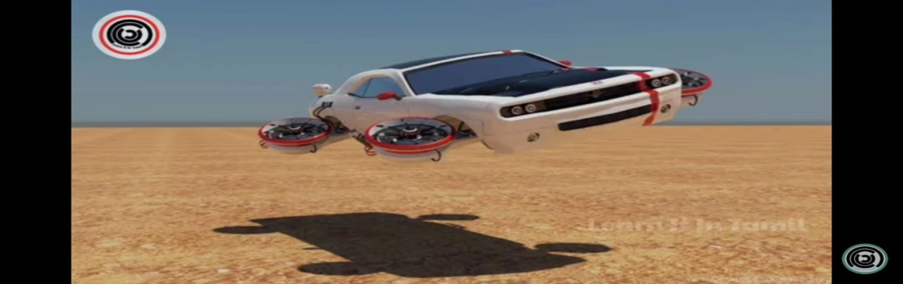
Introduction to simulation tools used
A protype of the ambulance will be designed and developed.
Tinkercad .–this is used for simulate and create a code for Arduino sensors.
8/12

Slide 9
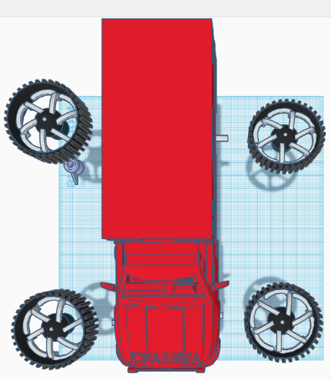
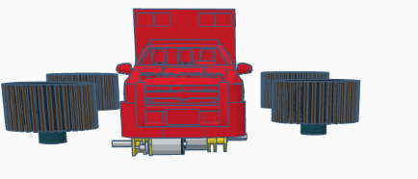
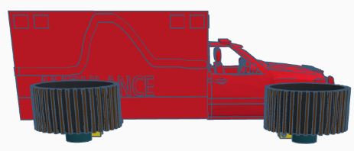
Work Done
9/12

Slide 10
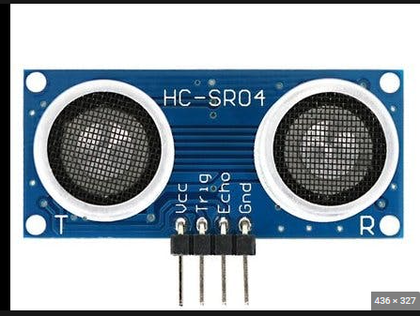
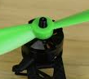
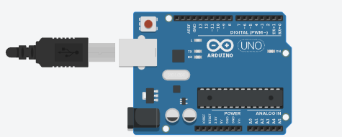
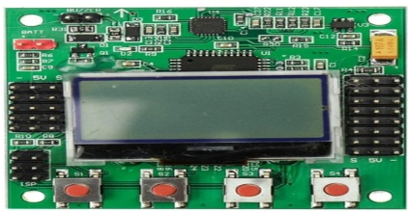
Outline of the work
Ultra sonic sensor
Tyre
Drone
Motor
Tyre
Drone
Motor
Ardiuno Uno
Flight controller
Tyre
Drone
Motor
Tyre
Drone
Motor
Motors connected with Ardiuno.
Drones connected with Flight controller.
10/12

Slide 11
References
Flying Car Transportation System: Advances, Techniques, and Challenges
Received December 28, 2020, accepted January 31, 2021, date of publication February 3, 2021, date of current version February 11, 2021.
Flying cars for green Transportation
Joule 3, 1180–1189, May 15, 2019 -2019 Published by Elsevier Inc.
Rajashekara, K., Wang, Q., & Matsuse, K. (2016). Flying cars: Challenges and propulsion strategies. IEEE Electrification Magazine, 4(1), 46-57.
EN-ROUTE TO URBAN AIR MOBILITY .
Date of publication: 7 March 2022 and published by Altran.
11/12

Slide 12
THANK YOU
12/12

